Slide 1

Introducing Tapestry

Slide 2

There’s an enormous body of research…on the positive impact of parent partnerships…not just in school but throughout life. We cannot educate our children without reaching out to their parents. When schools and families work together, children have a far better chance of not only being successful in school but being successful in life as well.
http://inclusiveschools.org (2015)

Slide 3
Safe Usage
No information from Tapestry can be shared with other people or published in any way. Only parents and carers who have signed the agreement have access to Tapestry.
★ This means that photographs or videos from Tapestry cannot be posted on a social networking site or displayed in a public place.
★ Anybody found to be misusing Tapestry or adding inappropriate comments will have their parent account withdrawn.
Notes:
Group observations – photos will be blurred. Individual observation photos may have other children in the background or they may be working with another child. No childs name will be in the observation notes except the child that is being observed.

Slide 4
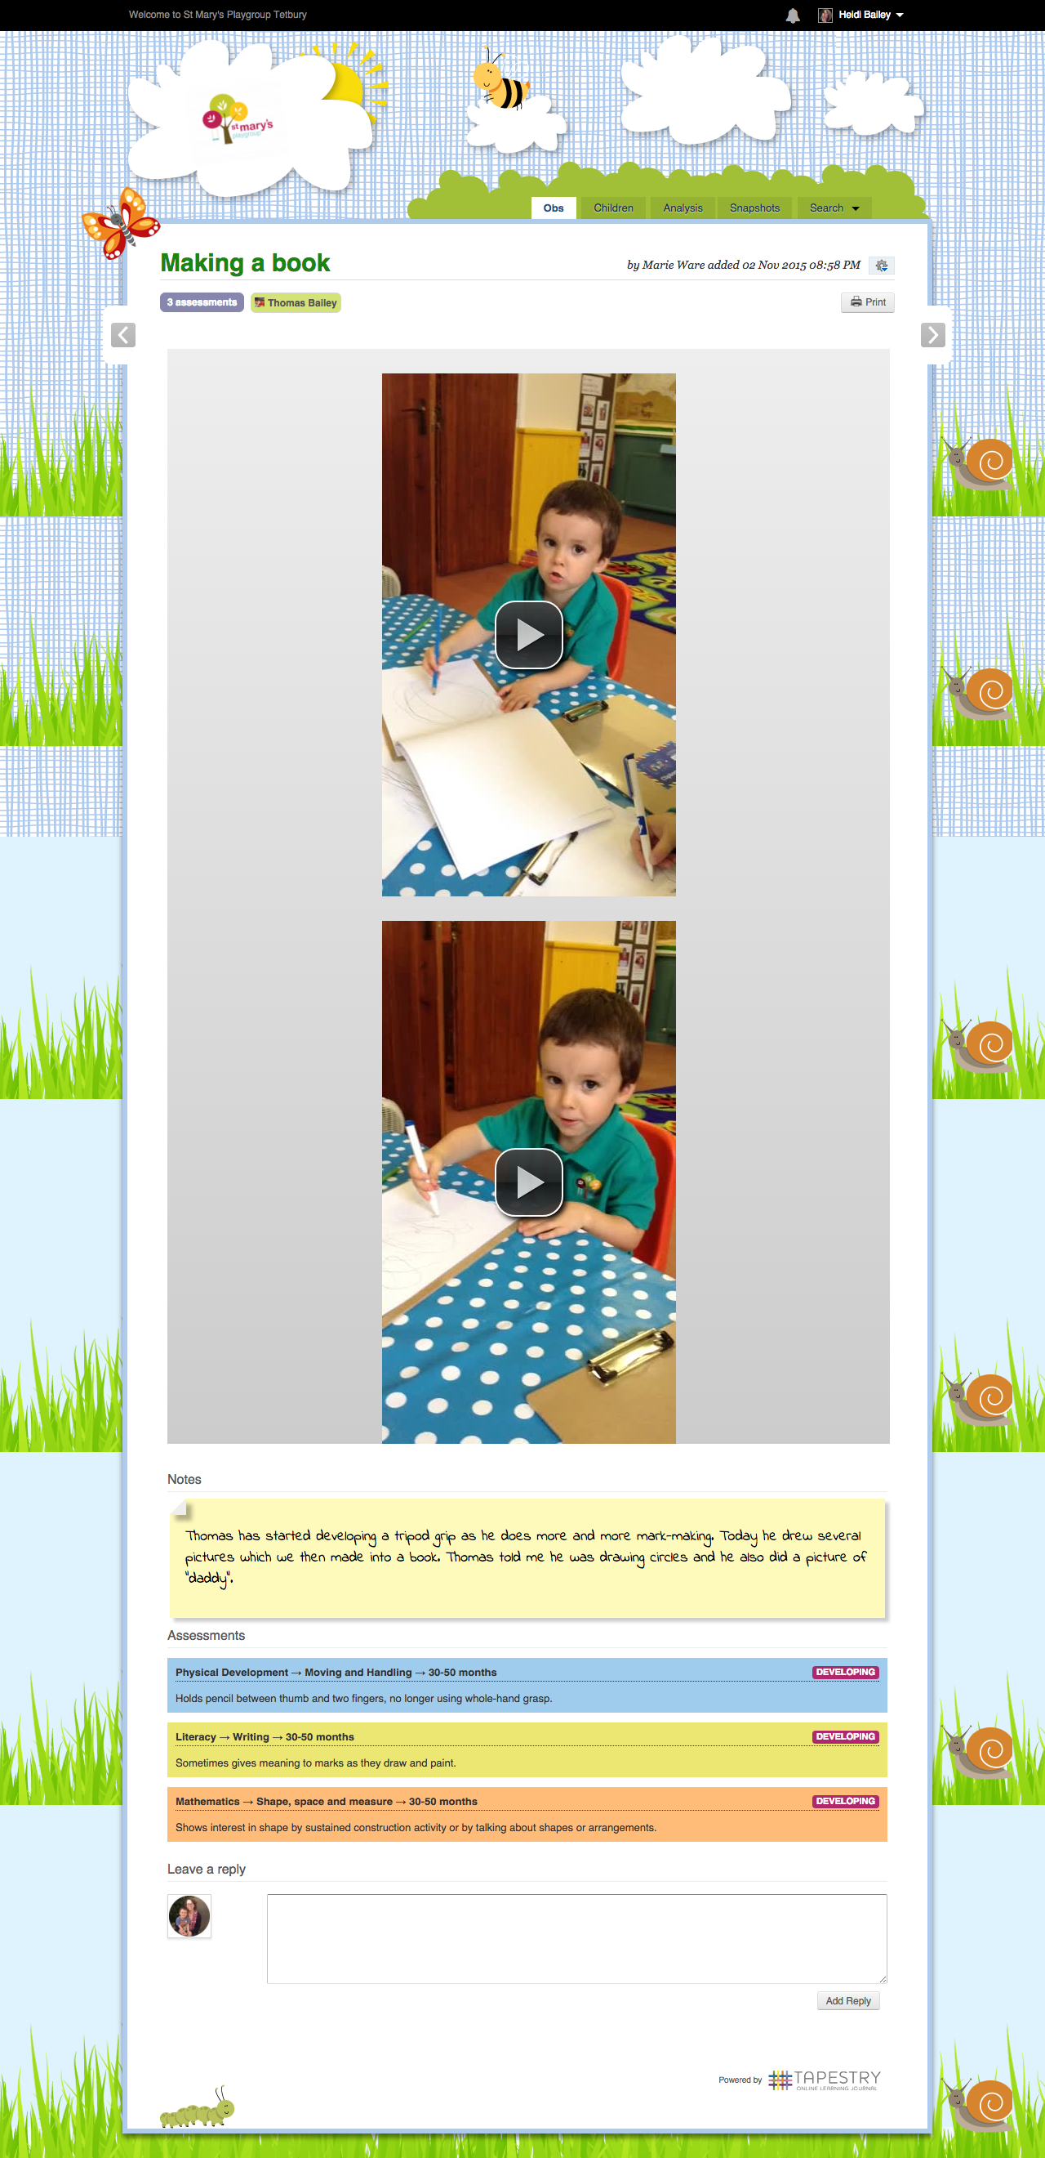

Example of an
observation
Photo or video taken during the observation
The areas of learning and statements the observation is covering
The description or notes made to explain what is happening or what the child is doing
Notes:
This is an example of what an observation will look like. Note, parents can’t see assessments.

Slide 5
Underneath the description of the observation there is a box where you can leave a reply’
Notes:
At the bottom of each observation, there is a box where you can ‘Leave a reply’. This allows you to comment on the activities we have been doing. It is included in your child’s Learning Journal. Replies cannot be deleted once they have been added so please make sure they are positive and supportive, as they will be shared with the whole class when we look at them together. Your replies may be replied to from here, however this is dependent on a number of factors so please don’t assume we will reply online. We do like to sleep! If you have any specific concerns about your child, this is NOT the place for it but as always, we are more than happy to chat at the beginning or end of each session.

Slide 6
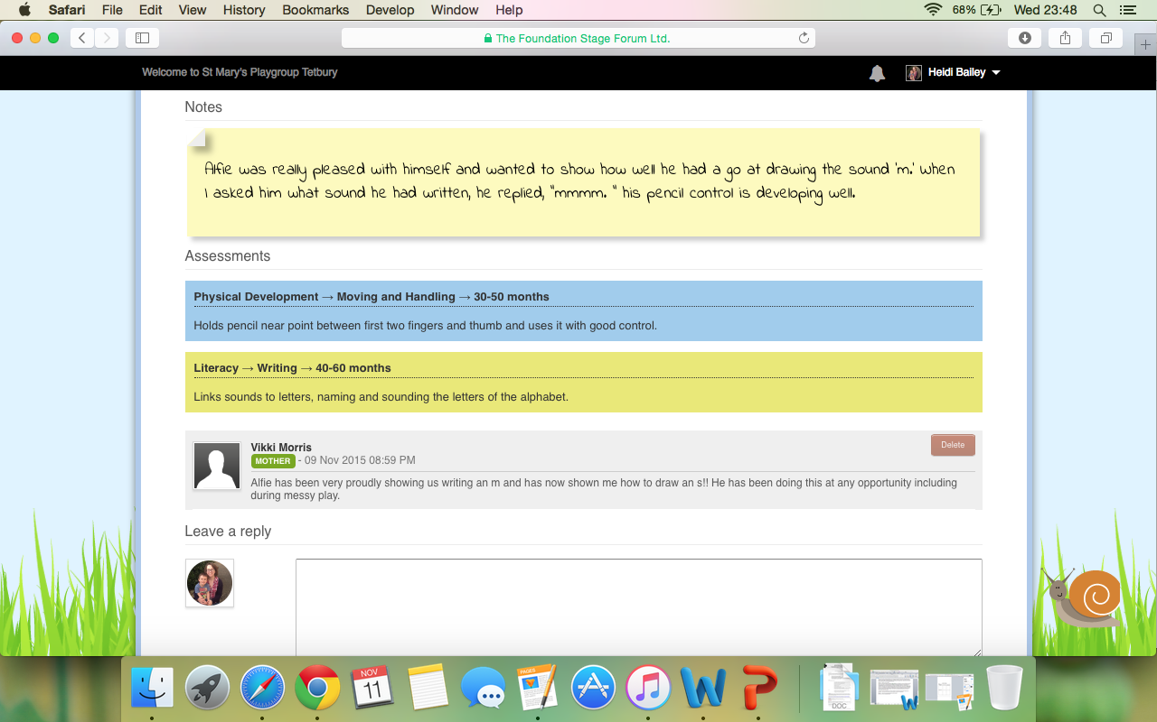
Example of a comment
Notes:
Alfie has been proudly showing us writing the letter m and has told me how to draw the letter s!

Slide 7
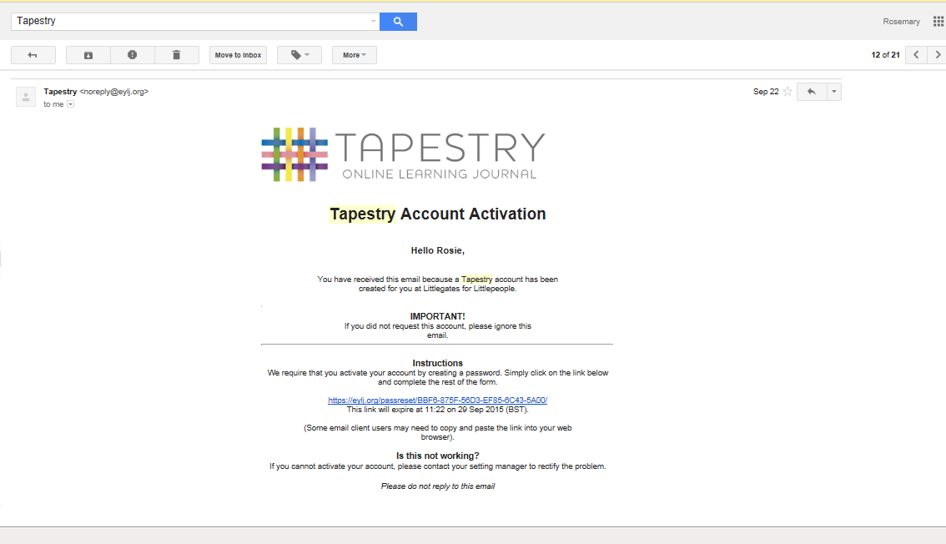
Get ready for your email?
Notes:
Follow the link in the email and create a password and pin number. Please make a note of your password and pin as you will need these to log into your account. Then click to activate your account. Please check your ‘junk’ folder if you haven’t received an email and let me know if you’ve had anything through by so I can clarify your email address with you. Just put a note in the contact book and I will look into it for you.

Slide 8
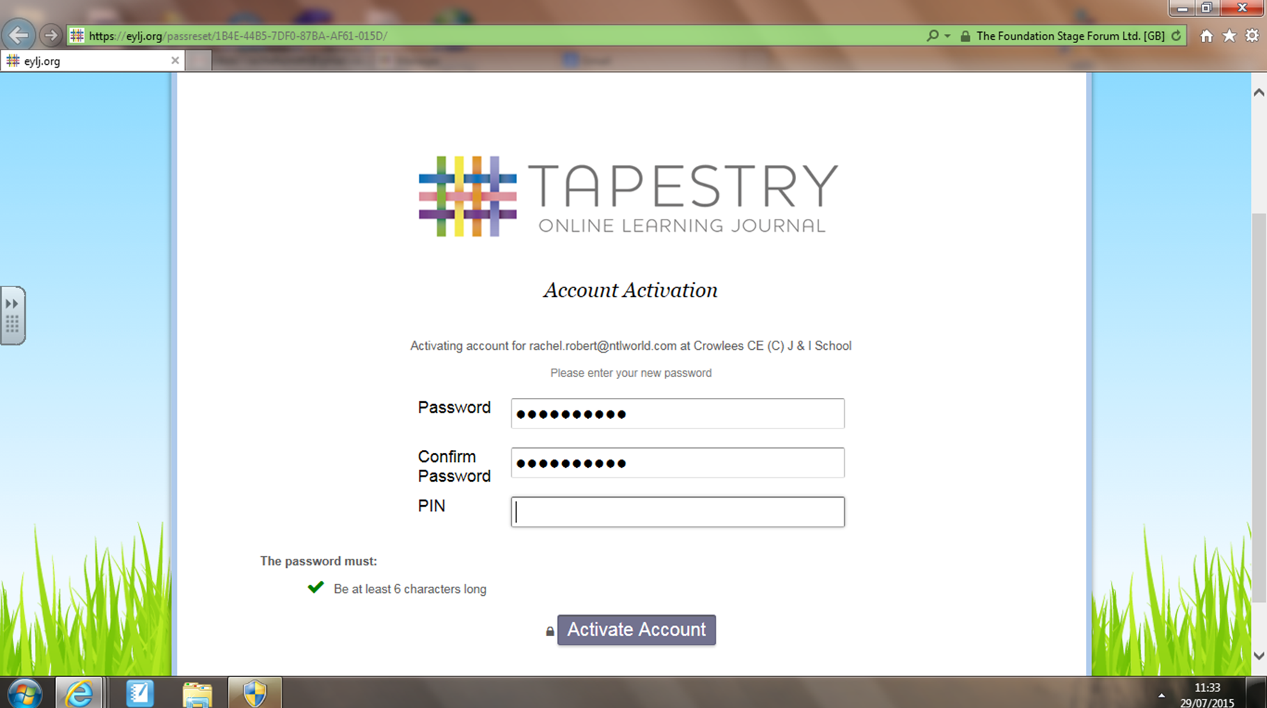
Don’t forget to activate your account?

Slide 9
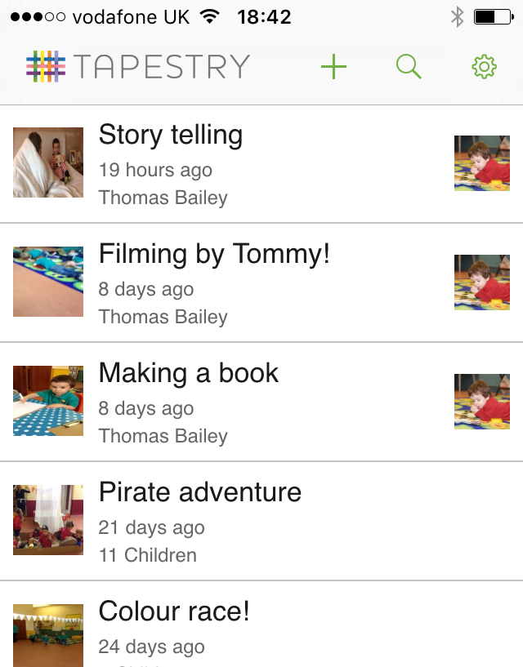
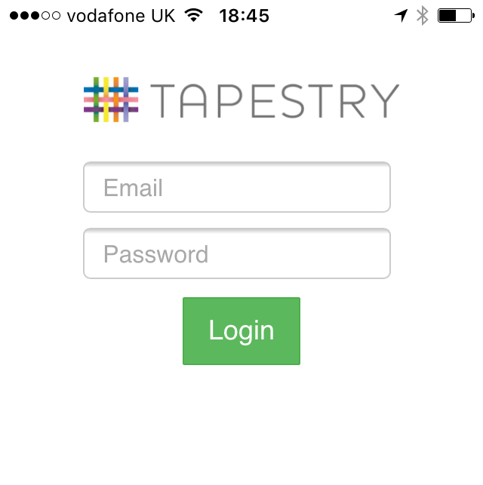
Don’t panic if you haven’t yet downloaded the app!
Notes:
If you have managed to download the app and set up a user then great, if not don’t panic – I have screenshots to give you an idea of what you will be able to see. Just to clarify - all the information about your child is stored on a secure website, which only people who have been invited to have access to. Obviously you can show your family the photos and videos, but it is only your login and downloading of the content is prohibited. So this is the login area you will see on phone or tablet once you have opened the app and once logged in, you will seen this screen with a list of all the observations that have been recorded. Please remember we have 30 children in class therefore we aim to update each child's learning journal at least once a week.

Slide 10
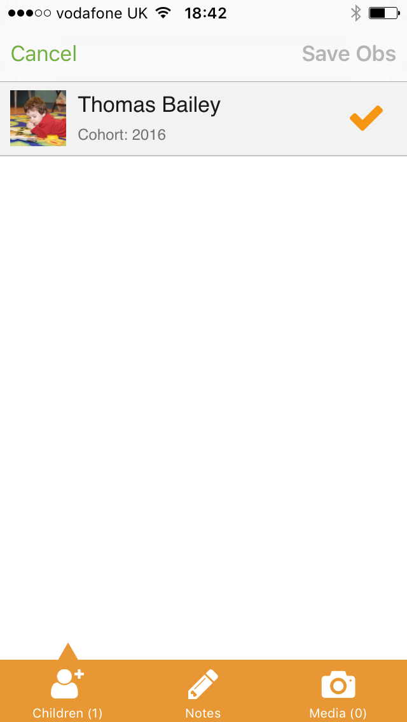
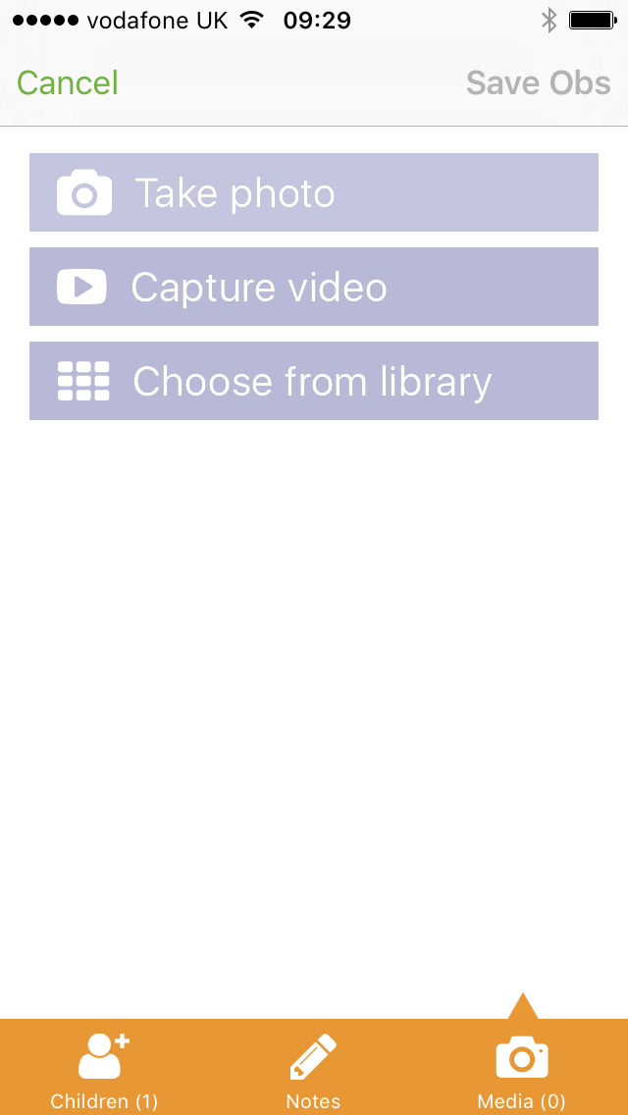
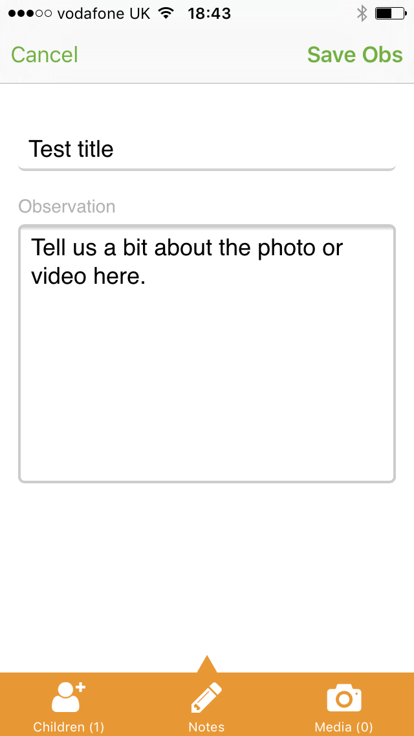
We value your input – share your ‘Wows’!
You will only be able to choose your child.
Click the camera to upload the photo or video
Tell us about it!
Notes:
Part of why we love Tapestry so much is how simple it is to use and leaving a reply or commenting on our observations once you’ve received an email update is only a few clicks away. We hope you will enjoy seeing your child through Tapestry and we would love you to share your child’s special moments from home with us and with Tapestry this couldn’t be easier. If you have a photo or video you’d like to share with us on your phone or tablet, simply log on, click on the + and upload.

Slide 11
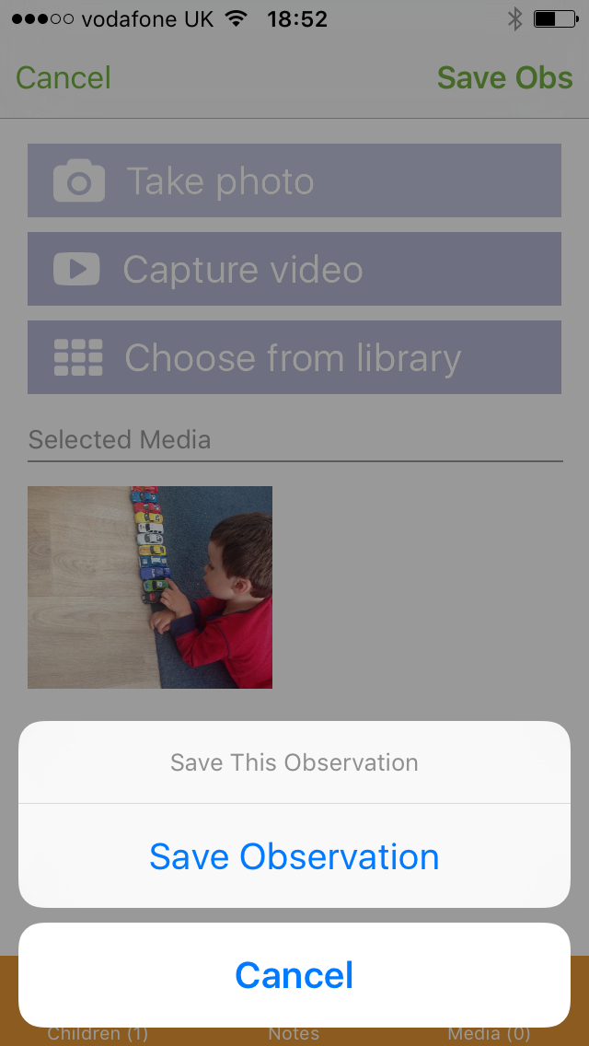
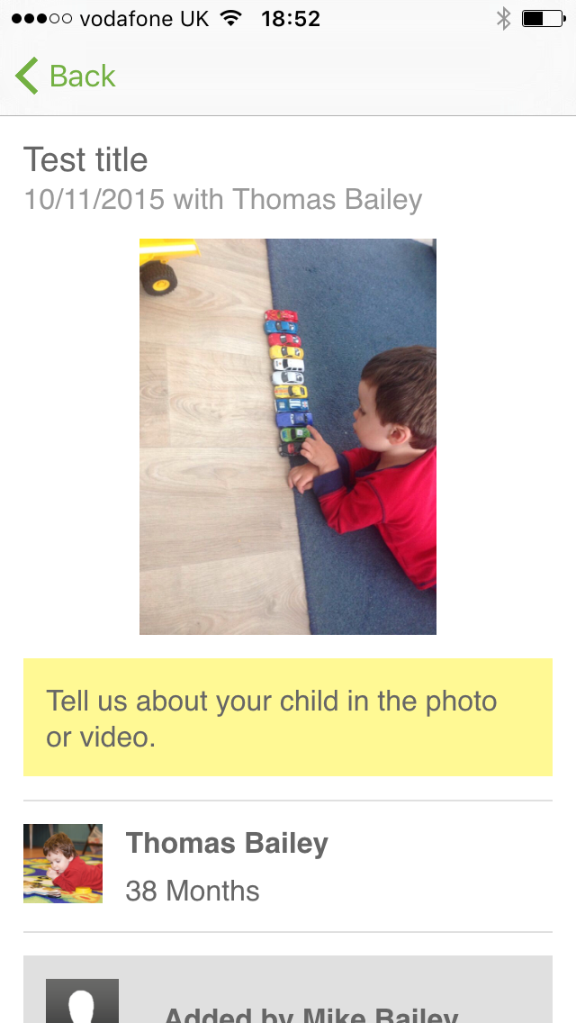
We’re almost there…
Click ‘Save Obs’ and then ‘save observation’
This is then what you’ll see once you’ve saved it

Slide 12
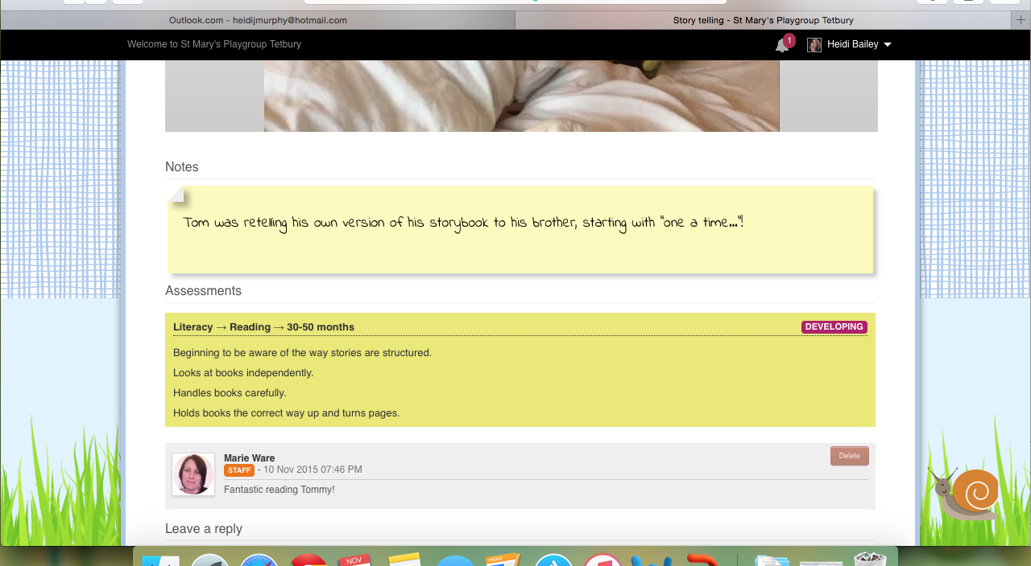
We can then assess from your WOW moments too!
Notes:
Once you have added a ‘Wow moment’ and clicked ‘save observation’, we then get an email notification. You may notice it saying ‘not in journal’ which is simply because we have to approve it before it can be ‘officially’ added. We will try to leave a reply to what you’ve added as we get really excited about seeing things from home(!) and we can then also add our assessments from what you’ve posted too – it really is a valuable tool!

Slide 13
Key points
Make sure you’ve signed up!
Contribute to your child’s learning journey by replying to observations
Talk to your child about what you have seen on tapestry
Add your own observations!

Slide 14

Thank you so much for coming!

